Slide 1
Project
How to behave if you are a guest in Russia
Poludova Alina
8th form pupil
Teacher Kobyzeva N. B.

Slide 2
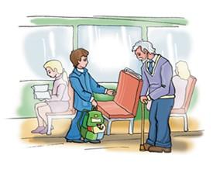
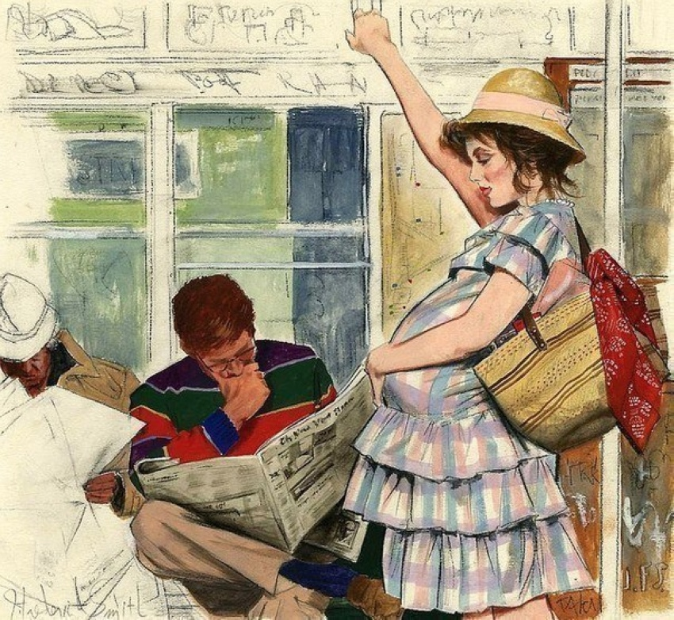
I would like to tell you some tips: 1) As well as in Britain you should give up the place on a bus in favour of old people and pragnent women

Slide 3
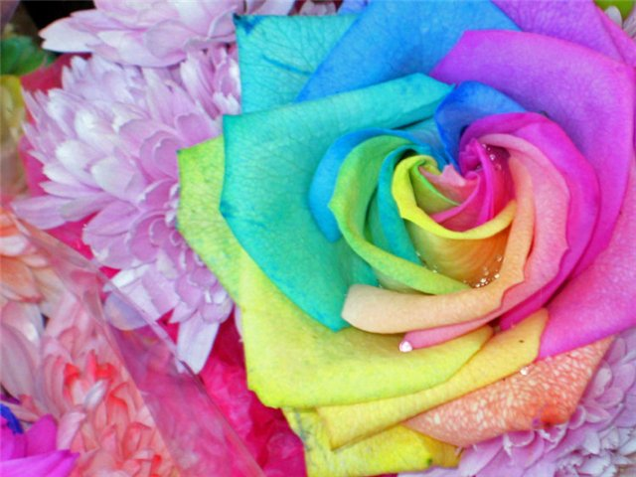
2) But you shoudn’t give flowers to men.

Slide 4
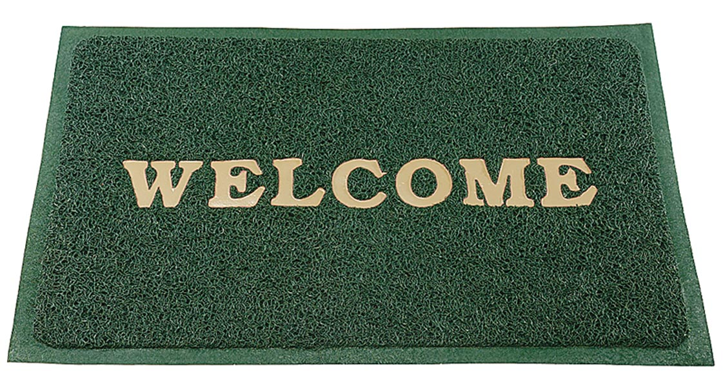
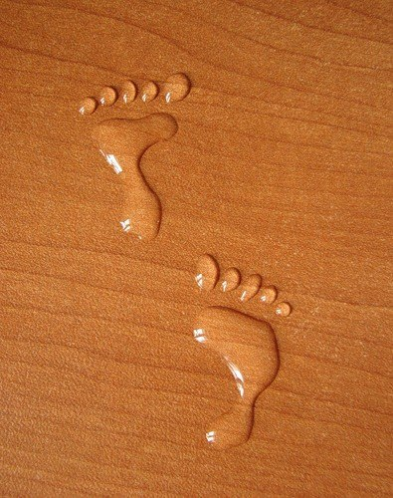
3) When in Russia don’t forget to take your shoes off when enter someone’s home.

Slide 5
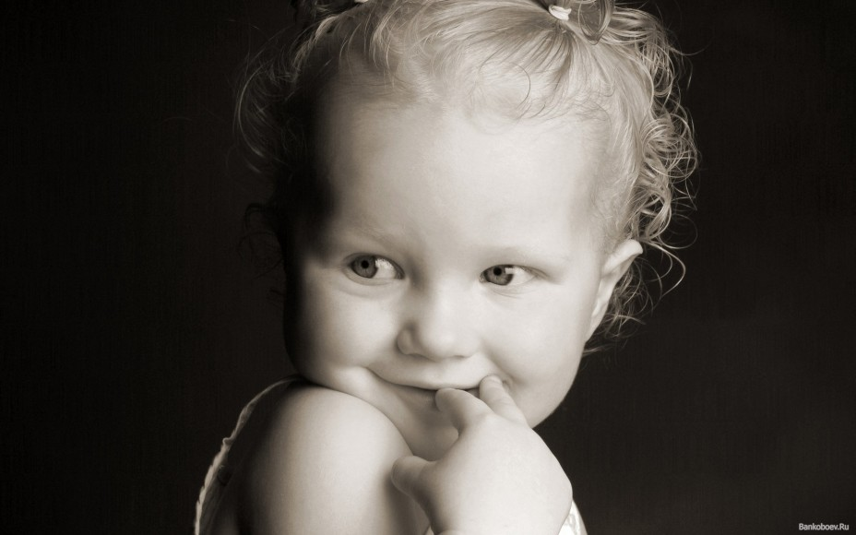
4) When in Russia don’t ask women and girls about their age.

Slide 6
5) Russian people don’t greet people with a kiss. When in Russia don’t greet people with a kiss

Slide 7
6) We remember that British don’t know our ways, and as long as you are friendly and polite from the heart we don’t mind that you behave a bit strangely.

Slide 8
Thank you for your attetion!

Slide 9
I used:
Textbook 8 th fotm

